Slide 1
Hair Analysis
So really, what can we find out from hair?

Slide 2
Hair can be very valuable to forensic scientists.
Need to be familiar with hair structure and chemistry.
A hair is composed of three layers: cuticle, cortex, and medulla.

Slide 3
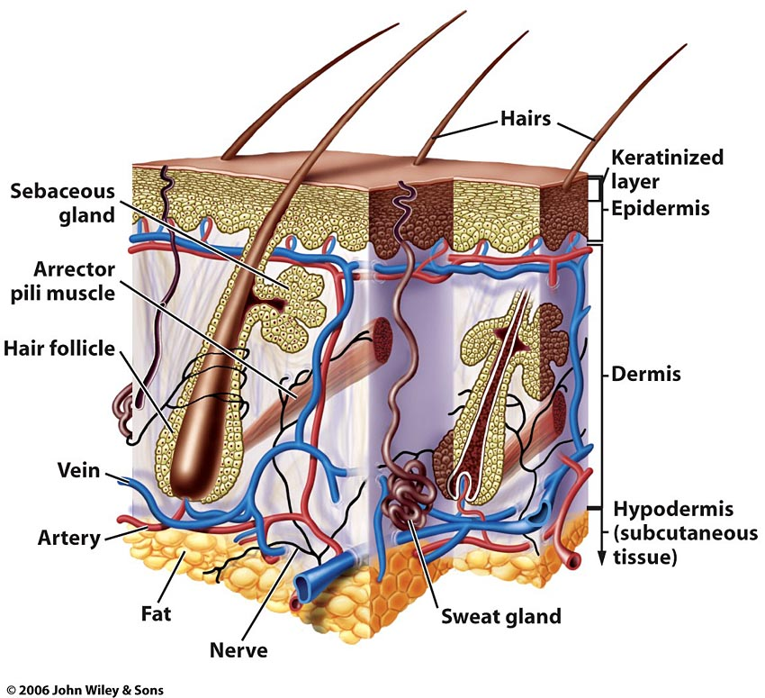

Slide 4
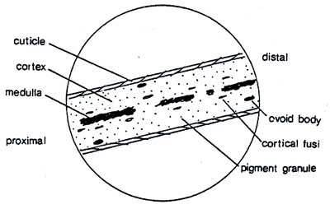
Structure of Hair
= away from root
= toward root
cuticle
cortex
Think of it like a pencil . . .
medulla

Slide 5
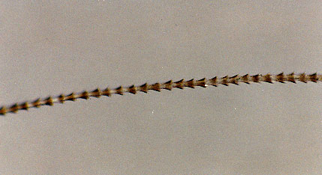
Cuticle
Hard, outside covering that protects the inner layers. Made of overlapping layers of scales. Differ in types and arrangements of scales.

Slide 6
Types of scales
Crown-like scales: found on very fine hair of rodents and bats, rarely in humans
Spinus or petal-like scales: protrude off from shafts of hair. NOT found on human, found on cats, seals, minks, etc.
Imbricate or flattened scales: overlap (like shingles on a roof). Found on humans and some animals

Slide 7
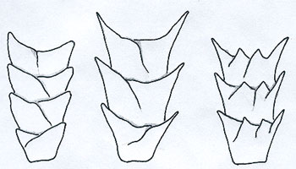
Crown-like scales
Return

Slide 8
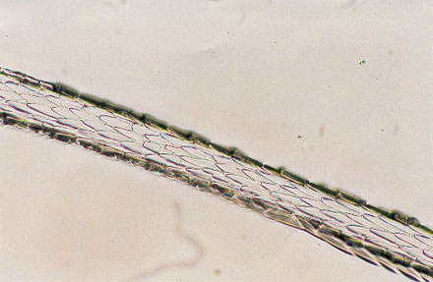
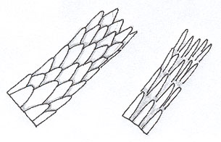
Spinus or petal-like scales
Return

Slide 9
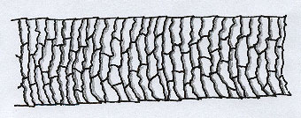
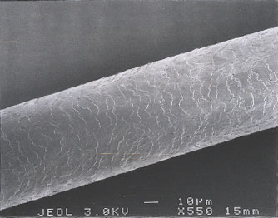
Imbricate or flattened scales
Return

Slide 10
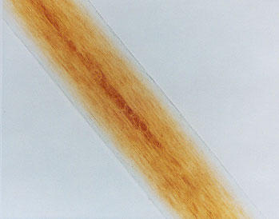
Cortex
Cortex: Made of cells within the cuticle. Makes up 75-90% of human hair. Contain pigment that give hair its color.
Forensic scientists use color, shape, and distribution of pigment granules.

Slide 11
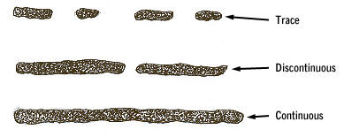
Medulla
Made of cells that run through the center of the cortex.
May be continuous, interrupted, fragmented, or absent.
Forensic Scientists use the medullary index, medullar pattern and shape.
fragmented
interrupted
continuous

Slide 12
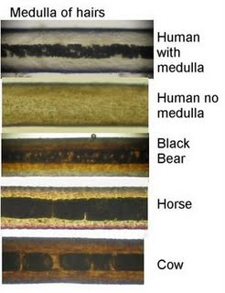
Medullary Index
=diameter of medulla / diameter of hair
Humans→ index is <1/3
Animals→ index is >1/2
Thus animals
generally have
a thicker medulla
than humans
Image from: http://bigfoot-evidence.blogspot.com/2009/07/hair-analysis.html

Slide 13
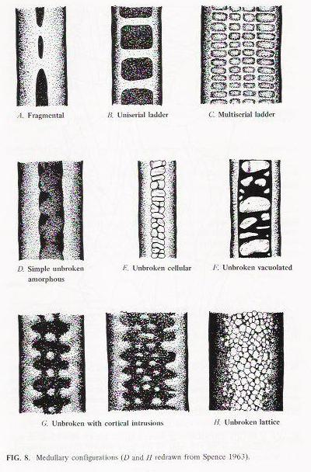
Image from: http://atcg.bio.cmich.edu/session3.htm

Slide 14
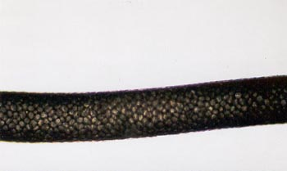
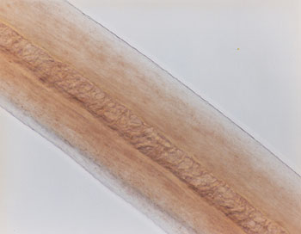
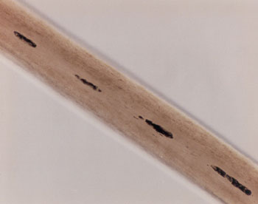
Animal
Continuous
Fragmented

Slide 15
The Root
Human roots look different based on whether they have been forcibly removed or if they are telogen hairs and have fallen out. Animal roots will vary, but in general have a spear shape.
Fallen out
Forcibly removed

Slide 16
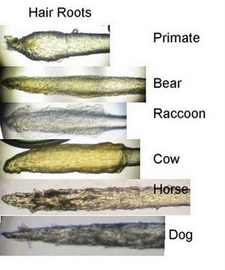
Root Comparison
Image from: http://bigfoot-evidence.blogspot.com/2009/07/hair-analysis.html

Slide 17
Hair Identification Factors
B/C humans treat their hair with color or other chemicals, this aids in identification
Dye can be in the cuticle and cortex
Bleaching removes the color and gives it a yellow tint.
Length of colored “roots” helps with id.
Hair grows 1 cm/month

Slide 18
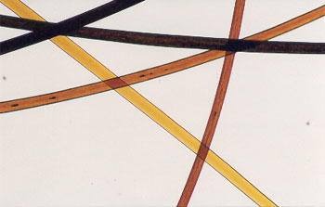
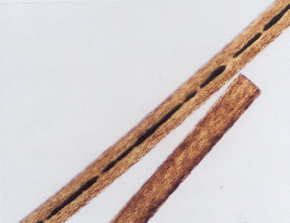
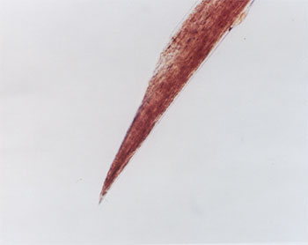
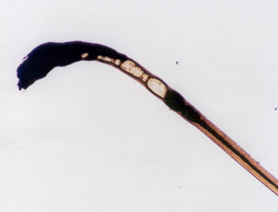
Scissor Cut
Colored Hair
Razor
Cut
Burned

Slide 19
Process of Analysis
1st determine whether hair is human or animal.
If human: they compare hair to that of suspects using comparison scopes.
Then determine part of body: scalp, body, beard, etc.
Hair can be used to determine race.
If animal: they ID the animal.

Slide 20
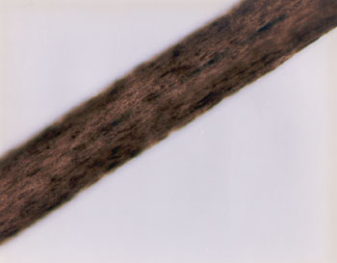
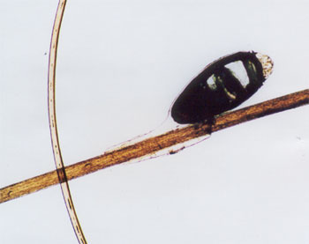
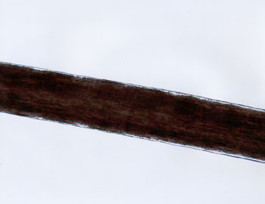
What’s This?
Ewww!!!!! Lice Egg Case
Negroid
Caucasian
Mongoloid

Slide 21
Other important points . . .
Hair is one of most common types of trace evidence
Hair CAN be used to RULE OUT suspects or scenarios and to CORROBORATE (support) other evidence
Hair NOT individual type evidence unless the root is present (can obtain DNA sample from live cells in hair follicle)

Slide 22
DNA from Hair
The root contains nuclear DNA. If the hair has been forcibly removed, some folicular tissue may be attached containing DNA.
The hair shaft contains abundant mitochondrial DNA, inherited only from the mother. It can be typed by comparing relatives if no DNA from the body is available.

